Slide 1
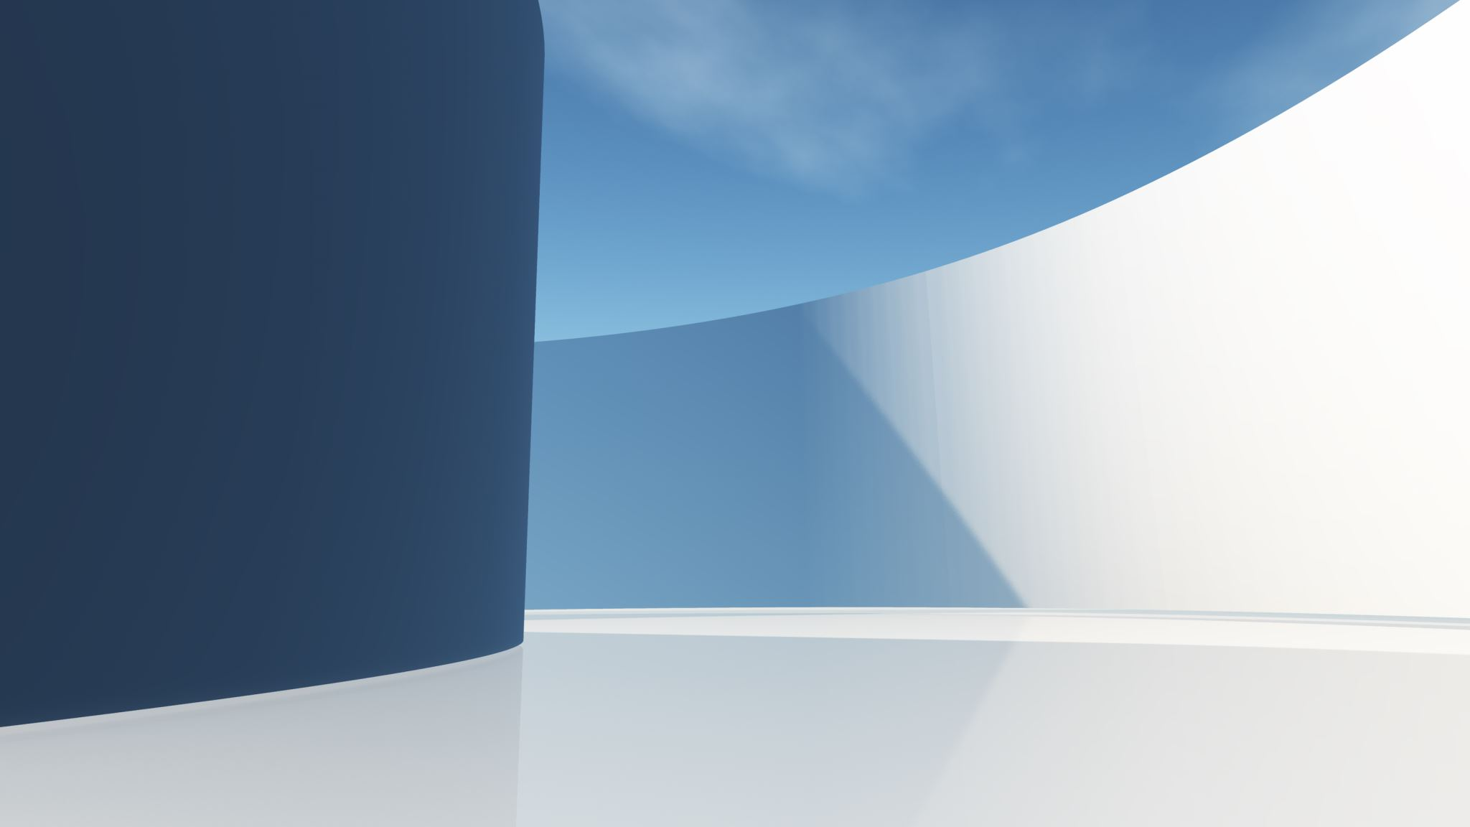
DISTRACTED DRIVER DETECTION BASED ON PRIORITIZED ALERTING
Presented by Team ID- MP23CSE053
Shailja Bahuguna (2017014)
Ruudra Amola (2016972)
Project Mentor- Mr. Rishi Kumar, Assistant professor,
Dept. of CSE

Slide 2
INTRODUCTION
Distracted driving is the act of driving while engaging in other activities which distract the driver's attention away from the road.
State of driver distraction can be studied in terms of 3 distinct categories:
Visual distractions involve taking one's eyes off the road.
Manual distractions involve taking one's hands off the steering wheel, such as an act of drinking.
Cognitive distractions occur when an individual is not mentally focused on the act of driving. Cognitive ones are the most fatal ones.
In a significant advancement in embedded distraction detection systems German tech firm Bosch, developed an “interior monitoring system” for cars that utilizes AI and cameras.
But the solution is yet to touch the wider masses. The problem of distraction is still not clear to drivers. It is still casual for people to have snacks and drinks while driving, listen to loud music, texting while driving without realizing the seriousness of the events it can lead up to.

Slide 3
PROBLEM STATEMENT
Distracted driver classification primarily involves two main approaches;
The first one involves using wearable setups with sensors that measure brain signals, heartbeat, and voluntary actions.
The other idea involves using computer vision systems based on AI and DL methods.
The problem statement for the present work can be stated as follows:
The problem aims to predict distracted acts of car drivers based on the State farm driver distraction image dataset from Kaggle, using Machine Learning and Deep learning techniques to achieve maximum accuracy. Also perform a comparative analysis between the two approaches.
The dataset is classified into 10 classes, representing 9 different causes of hinderance in driver attention. The 10th class represents “Safe driving”.

Slide 4
OBJECTIVES
The proposed work objectives are as follows:
To apply visualization and analytics to the collected image dataset at the initial stages.
To build a classification model using Linear SVM to predict images into right classes of distraction.
To establish a hierarchy of distraction priority levels based on fatality. For instance, texting while driving could be categorized as high-priority, while talking on the phone might be considered low-priority.
To evaluate and compile the results of the applied models.

Slide 5
LITERATURE SURVEY
This section outlines the research work on distracted driver detection in the last few years.
Driver Distraction Detection Trends:
Al Badawi reviewed Driver Drowsiness Detection Systems.
Two main measures: "Biological-Based" (wearable sensors) and "Image-Based" (camera).
Image-Based Measures:
Liang used SVM and logistic regression, achieving 81.1% accuracy.
Y. Xing introduced a CNN model using Kinect camera images, with CNN outperforming SVM.
Deep Learning Approaches:
Various models such as Alex-Net, InceptionV3, and CNN architectures (ResNet50, VGG-16, VGG-19, GA-weighted ensemble).
Bahari used Res-Net 50 achieving 94% accuracy.
Aljohani combined deep learning and machine learning with GA, achieving 99.80% accuracy.

Slide 6
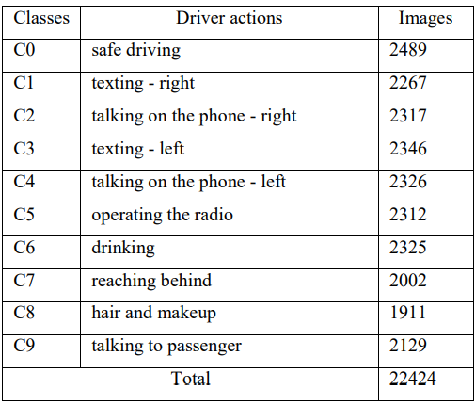
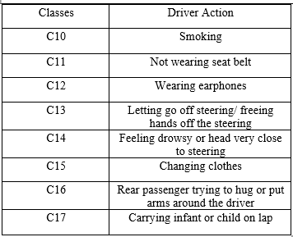
The Dataset
The dataset used in the project work is the State Farm Distracted Driver Detection image dataset from Kaggle.
The dataset has been spilt into training and testing subsets.
The training subset consists of 10 driver distraction classes(c0-c9) as identified. Class c0 represents “Safe driving”.
The images are colored and are of size 640×480 pixels. Each class encompasses nearly 2300 images.
On researching over distraction issues, we concluded that some additional classes could be incorporated into the existing dataset for better classification.

Slide 7
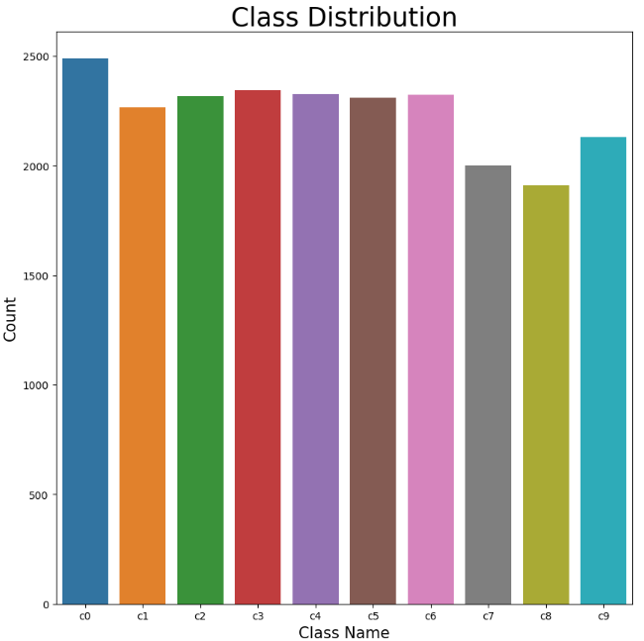
Dataset exploration and pre-processing
In the data visualization and examining phase, we first explored the distribution of images in the different classes.
Examination of composition of dataset, including division of training and testing sets.
Visual analysis of class distribution was generated using tools like ‘Seaborn’ and ‘Matplotlib’ libraries.
For pre-processing; each image in the dataset was resized to same dimensions which ensures the uniformity in input dataset.
The pixel values of the resized images were then flattened and stored in an array, while corresponding target labels (‘c0’ to ‘c9’) were stored in another array.

Slide 8
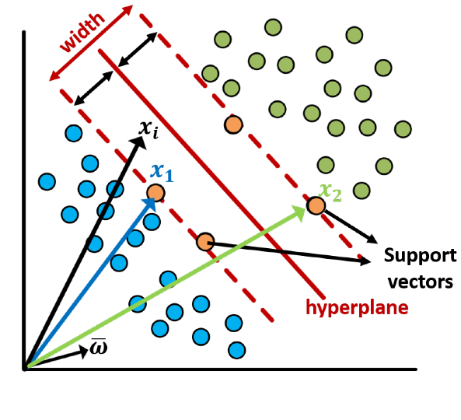
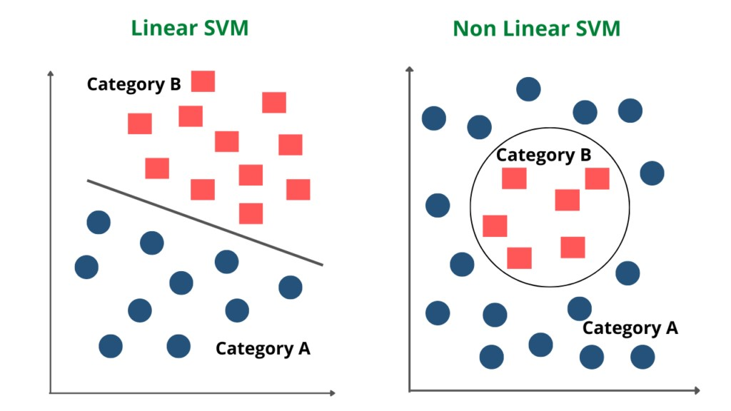
Algorithm used: Support Vector Machine
SVM is a supervised ML algorithm that is used in classification and regression problems.
The algorithm uses an input set of data that includes weights or labels associated with each element.
Its output is an optimal hyperplane that helps to separate and classify the dataset points or elements.
The best hyperplane is the one which maximizes the margin between the positive and the negative samples.
In the case of 2-D space, there are 2 kinds of situations;
One is the linearly separable hyperplane, when we can generate the hyperplane as a line.
And the other is non-linearly separable hyperplane, when the data points are inseparable using a line.

Slide 9
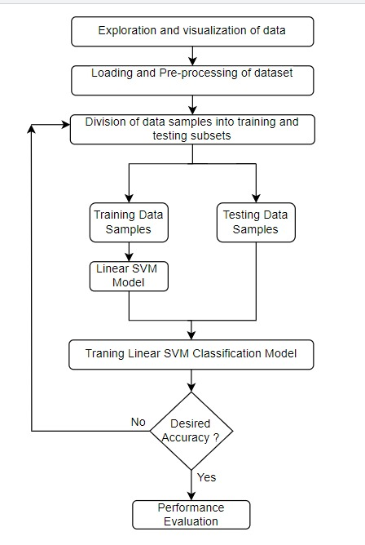
Model Training and Evaluation
For model training; the dataset is split into training and testing sets which ensures a balanced distribution of class labels.
A linear SVM model is selected and trained for its effectiveness in multi-class classification tasks.
Finally, the trained model was evaluated on the test set. Predictions are compared against the true labels to calculate the validation accuracy.
For the sample size of 1000 the model achieved an accuracy of 83% but a decrease in the test size from 20% to 10% gave an accuracy of 87%.
However, when the sample size was increased to 10,000, the accuracy increased to 98.95%.
We aim to improve the performance of the model with the change in implementation using DL based CNN approach.

Slide 10
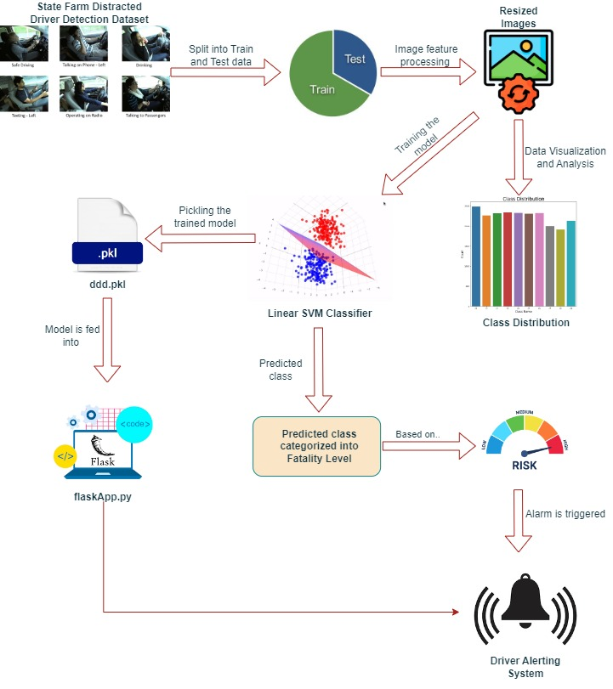
SYSTEM FLOW DIAGRAM

Slide 11
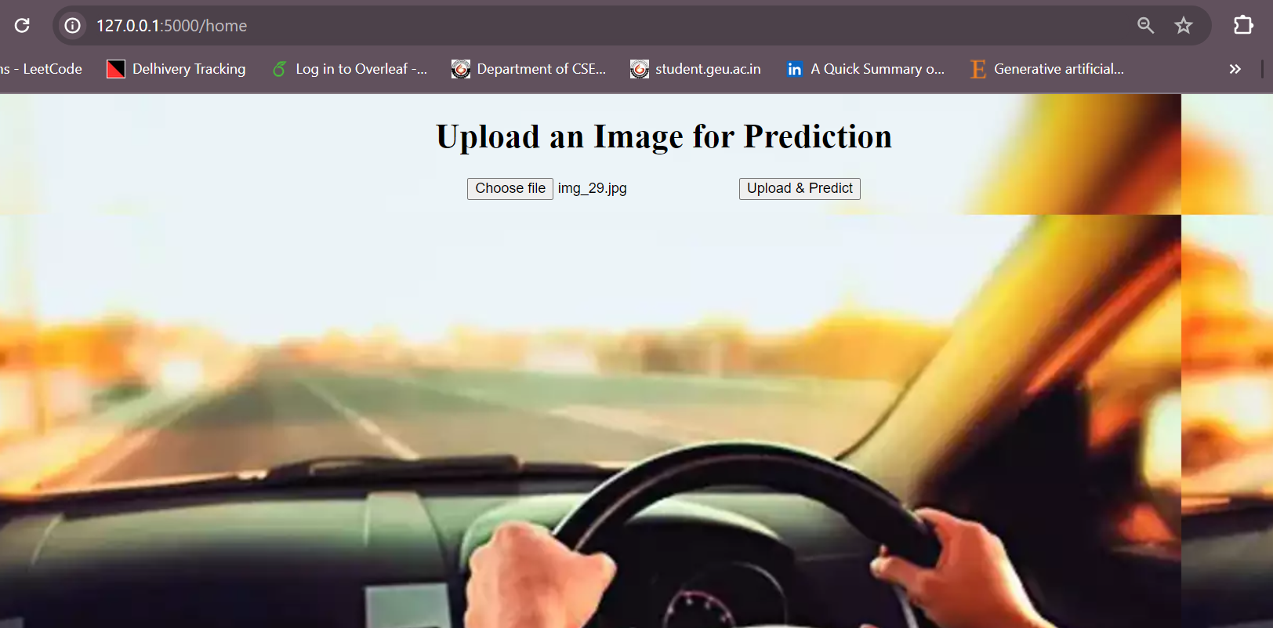
Deployment with Flask Framework
Flask application for local deployment and integrating it with a pre-trained ML model which is loaded from pickle file for image prediction.
Users interact with the system through a user-friendly web interface, where they can upload images for distraction prediction as shown in Fig.
Fig. Front-end (where users can upload the image)

Slide 12
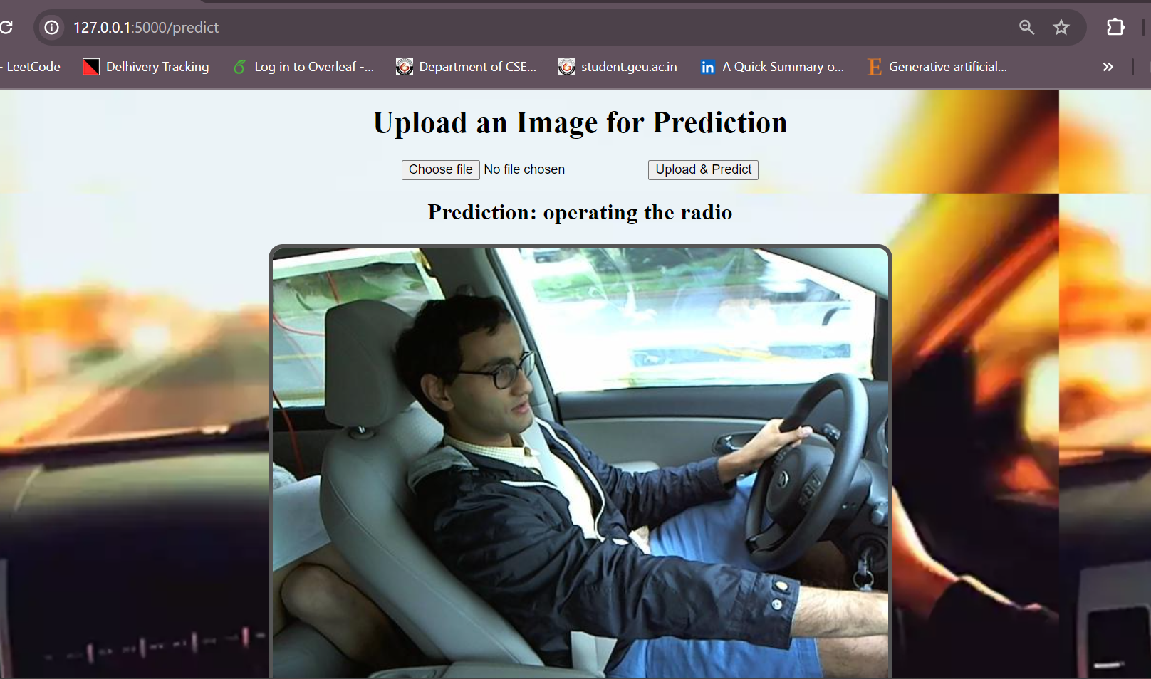
Uploading and Receiving Predictions
Upon uploading an image, the system processes it through the pre-trained model to predict distraction categories associated with the image content as shown in Fig.
The frontend, implemented using HTML and CSS, facilitates seamless interaction between users and the Flask backend.
Fig. Uploading Image and receiving Predictions

Slide 13
Status of Research Paper
Paper Title: Multimodal Analysis and Classification of Distracted Driver Categories: An SVM based framework.
Submitted to a peer reviewed conference in January 2024 under subject area; Data Mining and knowledge discovery- Machine Learning for Data Analysis.
Conference Name: International Conference on Innovative Engineering Sciences & Technological Research (ICIESTR-2024), organized by University of Technology and Applied Sciences (UTAS), Sultanate of Oman.
Response received on 20th March 2024. Status of paper submission: Rejected
Received 3 to 4 reviews stating improvement suggestions and specific appreciations for originality of work and clean and appropriate scientific tone along with accurate results.
Currently working on the content-based improvements and searching for strong data to support claims.

